Slide 1
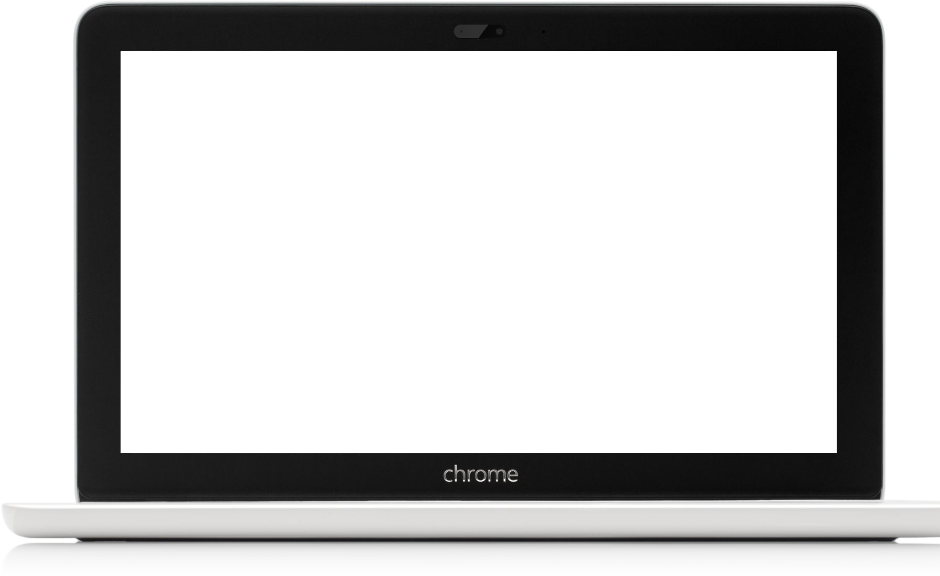
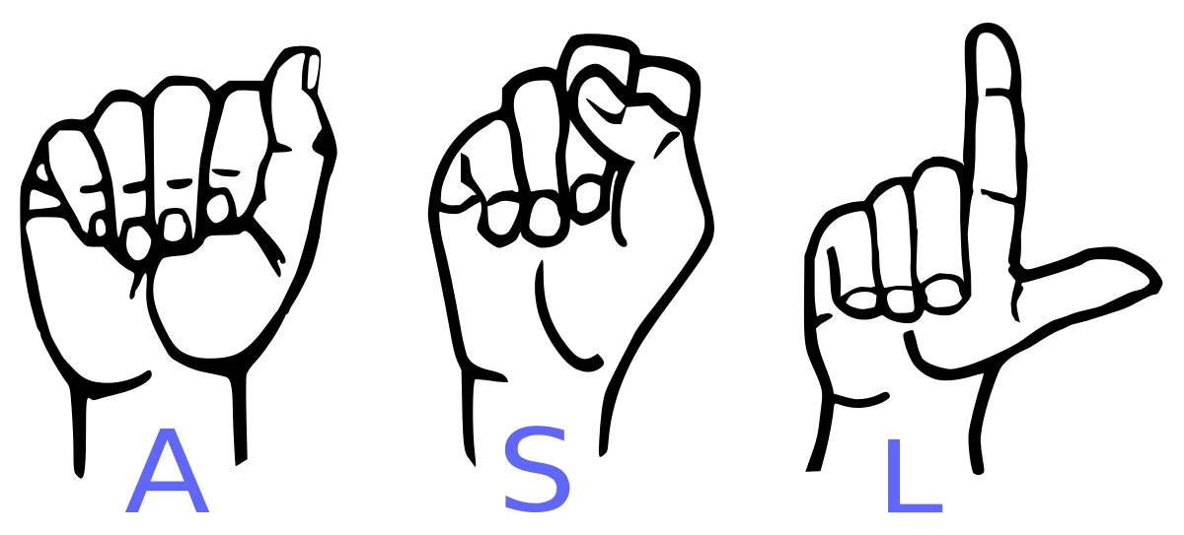
Sign Language Detection

Slide 2

Efforts by
Project Under the Guidance of
Dr. Parul Yadav
Ms. Pratibha Pandey
Atharv Pandey (1805213017)
Aditya Kumar Garg (1805213005)
Prakhar Pandey (1805213039)

Slide 3
TABLE OF CONTENT
INTRODUCTION
RELATED WORKS
DRAWBACKS
MOTIVATION
OBJECTIVE
SOFTWARE REQUIREMENTS
METHODOLOGY
CHALLENGES
FUTURE SCOPE
CONCLUSION

Slide 4
INTRODUCTION
Communication is very crucial to human beings, as it enables us to express ourselves. We communicate through speech, gestures, body language, reading, writing or through visual aids, speech being one of the most commonly used among them.
Unfortunately, for the speaking and hearing impaired minority, there is a communication gap. Visual aids, or an interpreter, are used for communicating with them. However, these methods are rather cumbersome and expensive and can't be used in an emergency.
Sign Language chiefly uses manual communication to convey meaning. This involves simultaneously combining hand shapes, orientations and movement of the hands, arms or body to express the speaker's thoughts.

Slide 5
INTRODUCTION
A system for sign language recognition that classifies finger spelling can solve this problem. Various machine learning algorithms are used and their accuracies are recorded and compared in this project.
Integrated our model with a GUI that would enable displaying of equivalent text obtained from recognised sign.

Slide 6
RELATED WORKS
[aeshpande3.github.io/A-Beginner%27s-Guide-To-Understanding-Convol utional-Neural-Networks-Part-2/] ( Familiarity with the concepts and advantages, as well as limitations, of convolutional neural networks.)
Aditi Kalsh, N.S. Garewal, “Sign Language Recognition for Deaf & Dumb”, International Journal of Advanced Research in Computer Science and Software Engineering, Vol 3, Issue 9, pp.103-106, 2013 ( This work includes a voice based, text based and video based interaction approach. Video chat technology continues to improve and one day may be the preferred means of mobile communication among the deaf. )
Byeongkeun Kang , Subarna Tripathi , Truong Q. Nguyen ”Real-time sign language fingerspelling recognition using convolutional neural networks from depth map” 2015 3rd IAPR Asian Conference on Pattern Recognition (ACPR) (This paper took the highly efficient initial step of an automatic fingerspelling recognition system using convolutional neural networks (CNNs) from depth maps. )
Zhi-hua Chen, Jung-Tae Kim, Jianning Liang, Jing Zhang, and Yu-Bo Yuan, “Real-Time Hand Gesture Recognition Using Finger Segmentation”, Hindawi Publishing Corporation, The Scientific World Journal, Vol 2014, Article ID 267872, pp.1-9, 2014 ( In this research, a promising technique to apply a B spline curvature concept for supporting a triangular-based feature extraction element in hand interpretation processes )

Slide 7
DRAWBACKS
Most projects had performance issues under low light environment.
Some had extra hardware requirements./

Slide 8
NOVELTY OF WORK
Planning to integrate text to speech for the text produced
Robust against similar postures in different light conditions and backgrounds
Fast detection process, allows the real time video application with low cost sensors, such as PC and USB camera

Slide 9
MOTIVATION
Sign language is learned by speaking and hearing impaired people, and usually it is not known by normal people, so it becomes a challenge for communication between a normal and a hearing impaired person.
It acted as the motivation for our project to develop something that could bridge the gap between hearing impaired and normal people and make communication between them easier.
Sign Language Detection system takes an input expression from hearing impaired function and gives output to the normal person in the form of text.

Slide 10
OBJECTIVE
Our project aims to create a computer application and train a model which when shown a real time video of hand gestures of American Sign Language shows the output for that particular sign in text format on the screen.

Slide 11

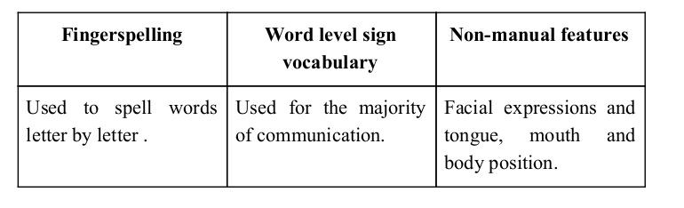
Sign language is a visual language and consists of 3 major components:

Slide 12
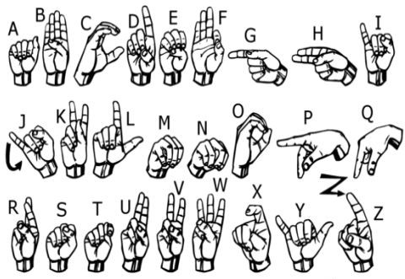
We implemented 27 symbols(A-Z, blank) of ASL in our project.

Slide 13
Software Requirements
Python
Tensorflow
OpenCV
NumPy
Matplotlib
Hunspell
Keras
PIL

Slide 14
Methodology

Slide 15
How we generated data set and did Data Preprocessing ?

Slide 16
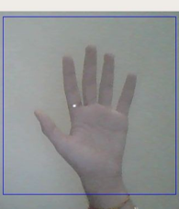
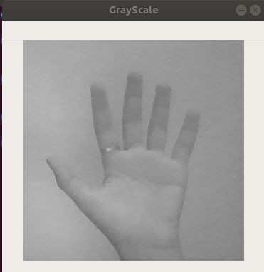
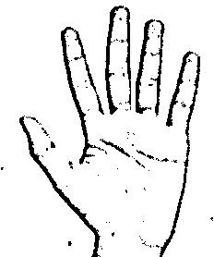
Image Post Gaussian Blur
Capturing Raw Image
Gray Scale Image

Slide 17
Why we Created our own Dataset ?

Slide 18
➔ For the project we tried to find already made datasets but we couldn’t find dataset in the form of raw images that matched our requirements.
➔ All we could find were the datasets in the form of RGB values.
➔ Hence we decided to create our own data set.

Slide 19
Gesture Classification

Slide 20
Layer 1
Layer 2
Classify between Similar Symbols
Classify between 27 Symbols

Slide 21
Algorithm Layer 1:
Apply gaussian blur filter and threshold to the frame taken with opencv to get the processed image after feature extraction.
This processed image is passed to the CNN model for prediction and if a letter is detected for more than 50 frames then the letter is printed and taken into consideration for forming the word.
Space between the words are considered using the blank symbol.

Slide 22
Algorithm Layer 2:
We detect various sets of symbols which show similar results on getting detected.
We then classify between those sets using classifiers made for those sets only.
In our testing we found that following symbols were not showing properly and were giving other symbols also :
For D
For U
For I
For S
: R and U
: D and R
: T, D, K and I
: M and N

Slide 23
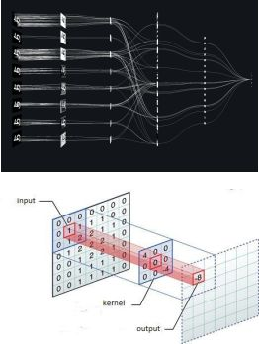
Convolutional Neural Networks
CNNs consist of multiple convolutional layers each layer containing numerous “filters” which perform feature extraction.
Initially these “filters” are random and by training, the feature extraction gets better by better.
It’s primarily used for image classification.

Slide 24
Our CNN Classifier Model

Slide 25
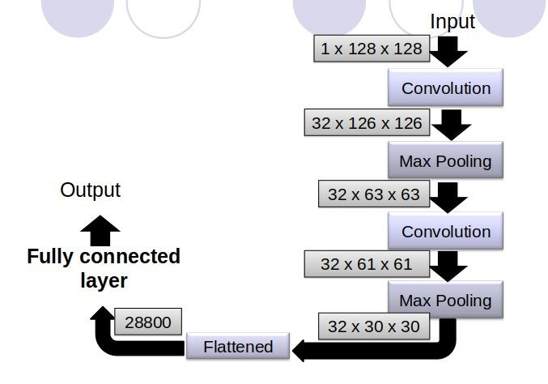

Slide 26
Finger Spelling Sentence Formation

Slide 27
Implementation
Whenever the count of a letter detected exceeds a specific value and no other letter is close to it by a threshold we print the letter and add it to the current string(In our code we kept the value as 50 and difference threshold as 20).
Otherwise we clear the current dictionary which has the count of detections of present symbol to avoid the probability of a wrong letter getting predicted.
Whenever the count of a blank(plain background) detected exceeds a specific value and if the current buffer is empty no spaces are detected.
In other case it predicts the end of word by printing a space and the current gets appended to the sentence below.

Slide 28
Autocorrect feature
A python library Hunspell_suggest is used to suggest correct alternatives for each (incorrect) input word and we display a set of words matching the current word in which the user can select a word to append it to the current sentence.This helps in reducing mistakes committed in spellings and assists in predicting complex words.

Slide 29
Challenges
We couldn’t find a dataset with raw images of all the asl characters so we made our own dataset.
Second issue was to select a filter for feature extraction. We tried various filter including binary threshold, canny edge detection, gaussian blur etc. ,of which gaussian blur filter was giving better results.
Issues were faced relating to the accuracy of the model we trained in earlier phases which we eventually improved by increasing the input image size and also by improving the dataset.

Slide 30
Limitations of our model
The model works well only in good lighting conditions.
Plain background is needed for the model to detect with high accuracy.

Slide 31
Future Scope
We are planning to achieve higher accuracy even in case of complex backgrounds by trying out various background subtraction algorithms.
We are also thinking of improving the preprocessing to predict gestures in low light conditions with a higher accuracy.
Can be integrated with google meet, zoom.

Slide 32
CONCLUSION
Robust against similar postures in different light conditions and backgrounds
Fast detection process, allows the real time video application with low cost sensors, such as PC and USB camera

Slide 33
Thank You !

